Slide 1
NLP

Slide 2
Introduction to NLP
Word Distributions

Slide 3
Word Distributions
Words are not distributed evenly!
Same goes for letters of the alphabet (ETAOIN SHRDLU), city sizes, wealth, etc.
Usually, the 80/20 rule applies
80% of the wealth goes to 20% of the people or it takes 80% of the effort to build the easier 20% of the system
more examples coming up…

Slide 4
Shakespeare
Romeo and Juliet:
And, 667; The, 661; I, 570; To, 515; A, 447; Of, 382; My, 356; Is, 343; That, 343; In, 314; You, 289; Thou, 277; Me, 262; Not, 257; With, 234; It, 224; For, 223; This, 215; Be, 207; But, 181; Thy, 167; What, 163; O, 160; As, 156; Her, 150; Will, 147; So, 145; Thee, 139; Love, 135; His, 128; Have, 127; He, 120; Romeo, 115; By, 114; She, 114; Shall, 107; Your, 103; No, 102; Come, 96; Him, 96; All, 92; Do, 89; From, 86; Then, 83; Good, 82; Now, 82; Here, 80; If, 80; An, 78; Go, 76; On, 76; I'll, 71; Death, 69; Night, 68; Are, 67; More, 67; We, 66; At, 65; Man, 65; Or, 65; There, 64; Hath, 63; Which, 60;
…
A-bed, 1; A-bleeding, 1; A-weary, 1; Abate, 1; Abbey, 1; Abhorred, 1; Abhors, 1; Aboard, 1; Abound'st, 1; Abroach, 1; Absolved, 1; Abuse, 1; Abused, 1; Abuses, 1; Accents, 1; Access, 1; Accident, 1; Accidents, 1; According, 1; Accursed, 1; Accustom'd, 1; Ache, 1; Aches, 1; Aching, 1; Acknowledge, 1; Acquaint, 1; Acquaintance, 1; Acted, 1; Acting, 1; Action, 1; Acts, 1; Adam, 1; Add, 1; Added, 1; Adding, 1; Addle, 1; Adjacent, 1; Admired, 1; Ado, 1; Advance, 1; Adversary, 1; Adversity's, 1; Advise, 1; Afeard, 1; Affecting, 1; Afflicted, 1; Affliction, 1; Affords, 1; Affray, 1; Affright, 1; Afire, 1; Agate-stone, 1; Agile, 1; Agree, 1; Agrees, 1; Aim'd, 1; Alderman, 1; All-cheering, 1; All-seeing, 1; Alla, 1; Alliance, 1; Alligator, 1; Allow, 1; Ally, 1; Although, 1;
http://www.mta75.org/curriculum/english/Shakes/indexx.html (visited in Dec. 2006)

Slide 5
Stop Words
Fact:
250-300 most common words in English account for 50% or more of a given text.
Example:
“the” and “of” represent 10% of tokens. “and”, “to”, “a”, and “in” - another 10%. Next 12 words - another 10%.
Moby Dick Ch.1:
859 unique words (types), 2256 word occurrences (tokens). Top 65 types cover 1132 tokens (> 50%).
Token/type ratio:
2256/859 = 2.63

Slide 6
Power-law Distribution
Percentage of words
Power-law
Many words with a small frequency of occurrence
A few words with a very large frequency
High skew (asymmetry)
Comparing to a normal distribution:
Many people of a medium height
Almost nobody of a very high or very low height
Symmetry
Frequency/Occurrence of words
Slide from Qiaozhu Mei

Slide 7
Scaling the Axes
linear scale
log-log scale
Long-tail on a linear scale - straight line on a log-log plot

Slide 8
Power Law Distribution
The probability of observing an item of size ‘x’ is given by
Straight line on a log-log plot
normalization constant (probabilities over all x must sum to 1)
α : scaling exponent, or power law exponent

Slide 9
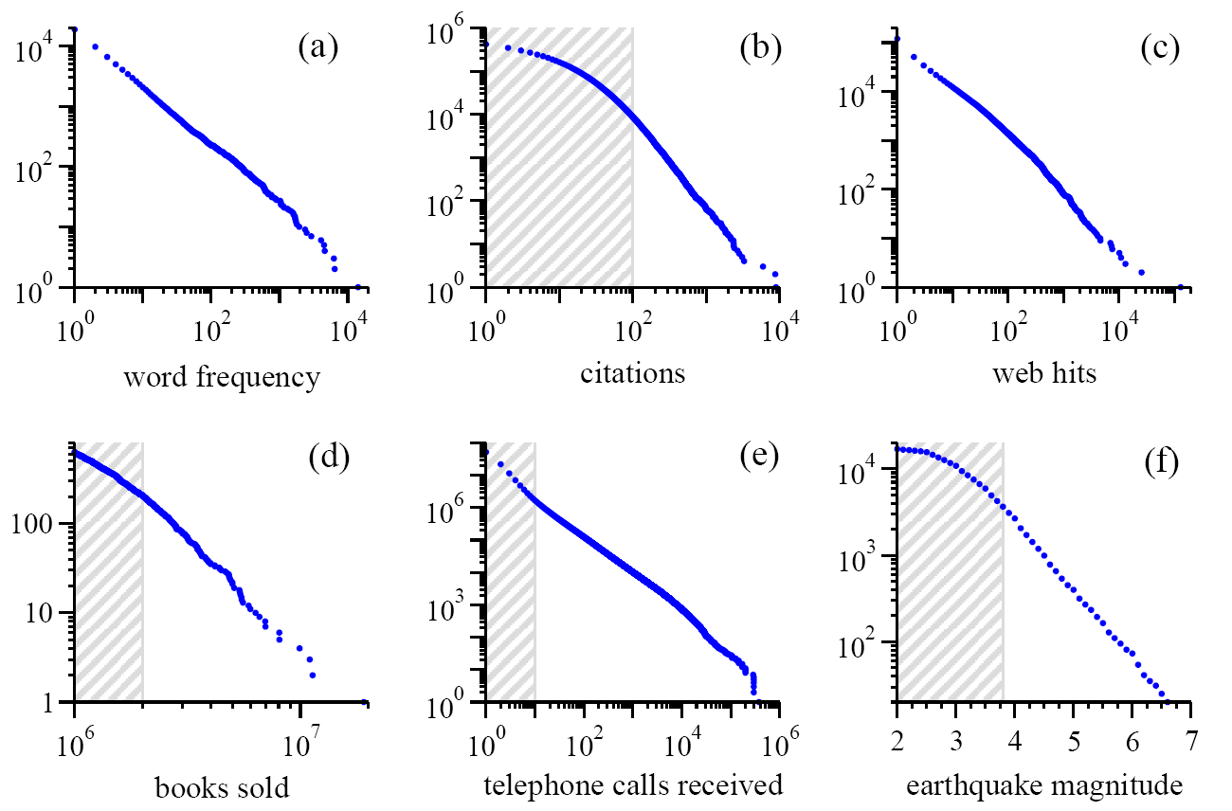
Power Laws Are Seemingly Everywhere note: these are cumulative distributions
Moby Dick
scientific papers 1981-1997
AOL users visiting sites ‘97
bestsellers 1895-1965
AT&T customers on 1 day
California 1910-1992
Source:MEJ Newman, ’Power laws, Pareto distributions and Zipf’s law’, Contemporary Physics 46, 323–351 (2005)

Slide 10
Zipf's law is fairly general!
Frequency of accesses to web pages
in particular the access counts on the Wikipedia page,
with s approximately equal to 0.3
page access counts on Polish Wikipedia (data for late July 2003)
approximately obey Zipf's law with a slope s about 0.5
Words in the English language
for instance, in Shakespeare’s play Hamlet with s approximately 0.5
Sizes of settlements
Income distributions amongst individuals
Size of earthquakes
Notes in musical performances
http://en.wikipedia.org/wiki/Zipf's_law
http://web.archive.org/web/20121101070342/http://www.nslij-genetics.org/wli/zipf/
http://www.cut-the-knot.org/do_you_know/zipfLaw.shtml

Slide 11
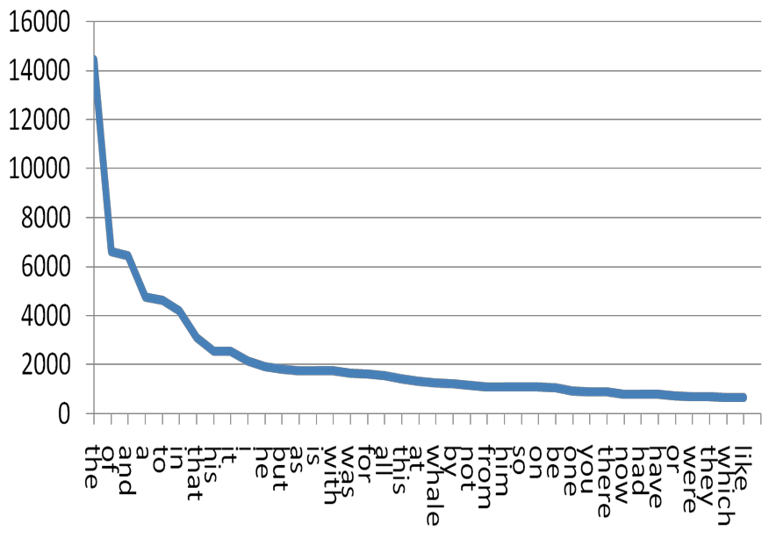
Another Way to Plot: Zipf’s Distribution
Word frequency
p(k) ~ k^{-α}
Words by rank

Slide 12
Zipf’s Law in Natural Language
– Constant ≈ 0.1 × Length of collection (in words)
– Not accurate at the tails, but accurate enough for our purposes
Rank x Frequency ≈ Constant

Slide 13
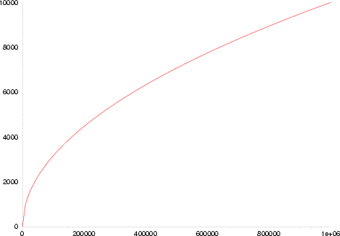
Heaps’ Law
Size of vocabulary: V(n) = Kn^{β}
In English, K is between 10 and 100, β is between 0.4 and 0.6.
V(n)
n
http://en.wikipedia.org/wiki/Heaps%27_law

Slide 14
Heaps’ Law (cont’d)
Related to Zipf’s law: generative models
Zipf’s and Heaps’ law coefficients change with language
Alexander Gelbukh, Grigori Sidorov. Zipf and Heaps Laws’ Coefficients Depend on Language. Proc. CICLing-2001, Conference on Intelligent Text Processing and Computational Linguistics, February 18–24, 2001, Mexico City. Lecture Notes in Computer Science N 2004, ISSN 0302-9743, ISBN 3-540-41687-0, Springer-Verlag, pp. 332–335.

Slide 15
NLP

